Slide 1
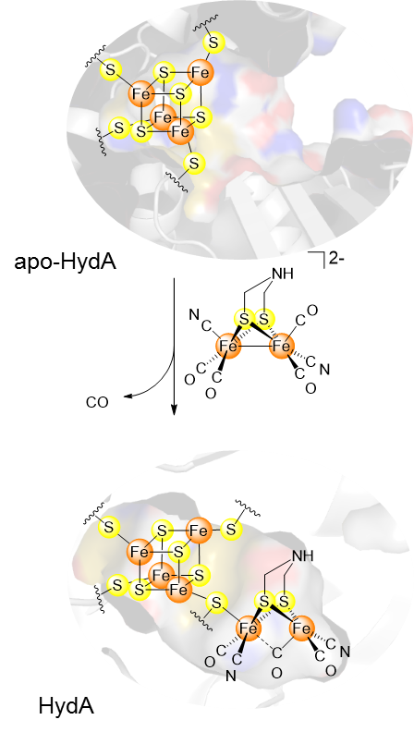
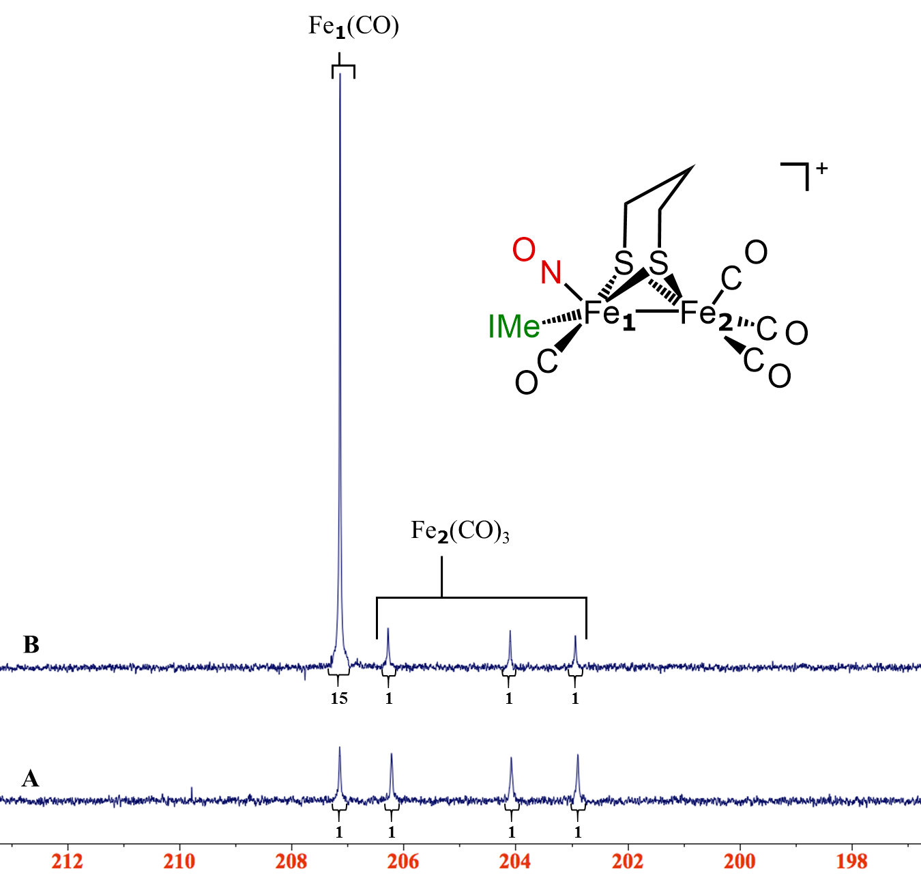
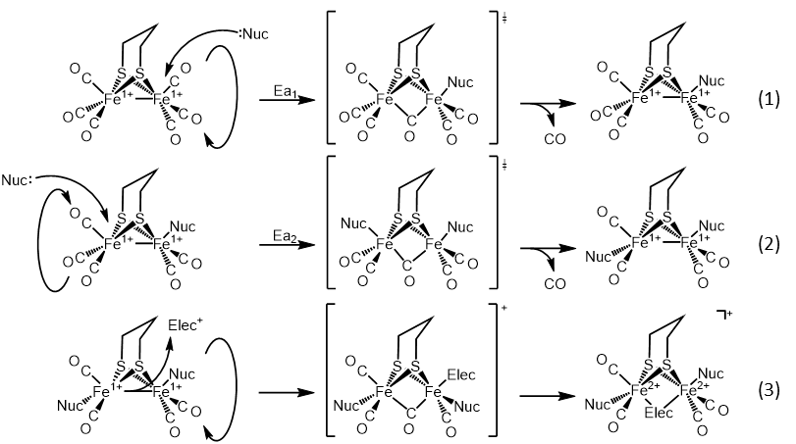
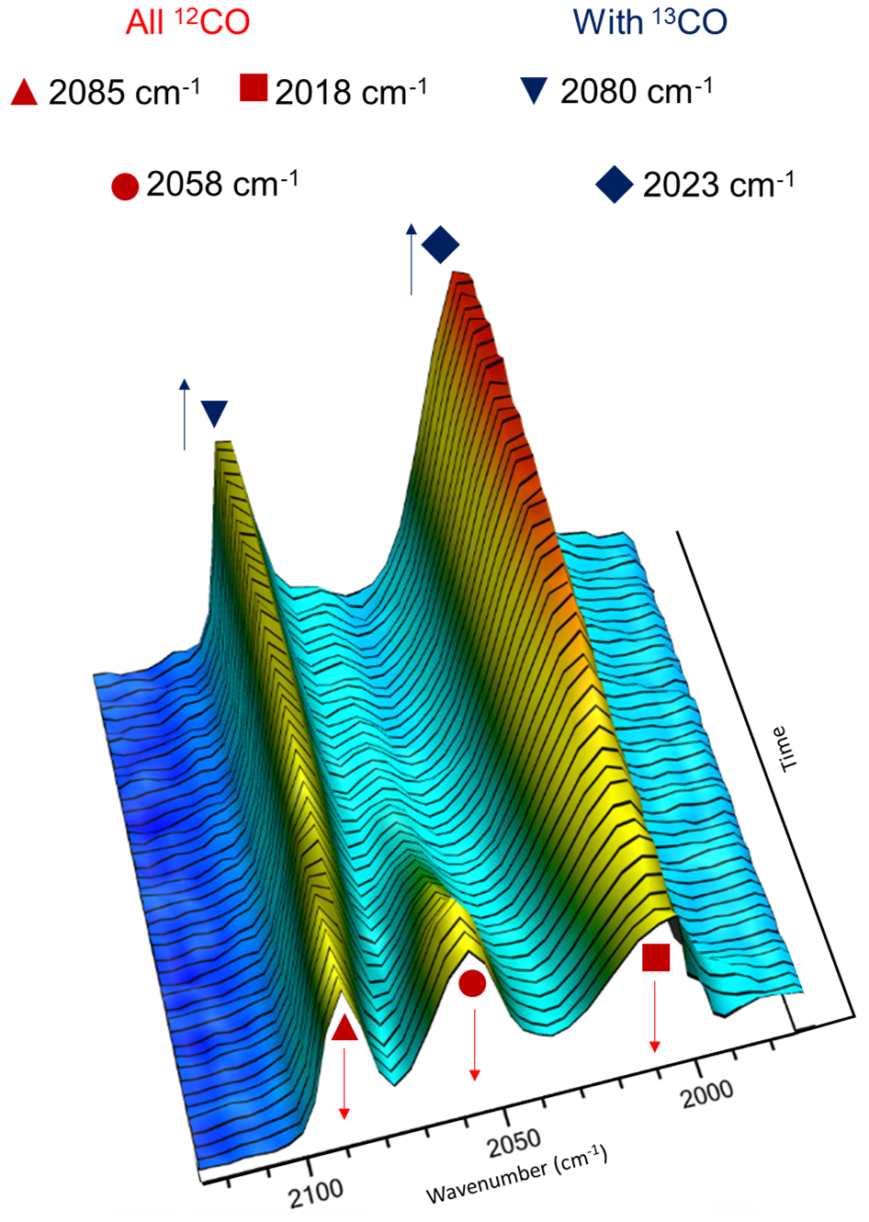
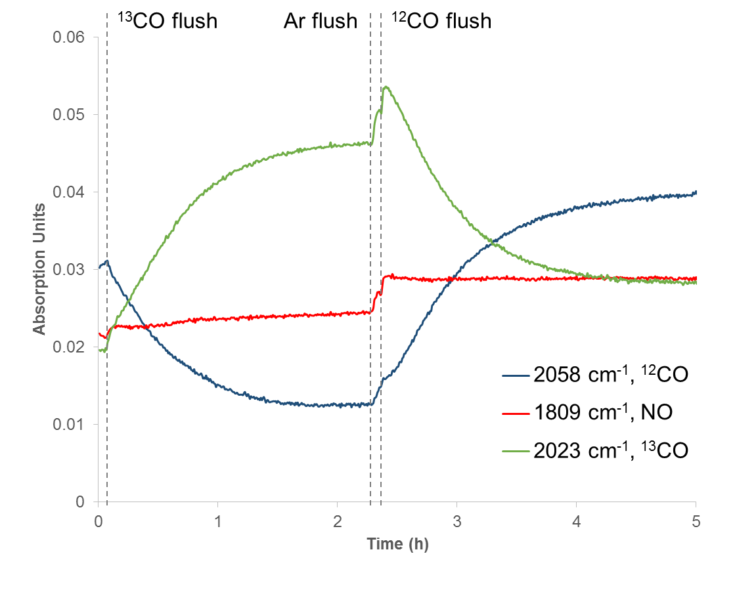
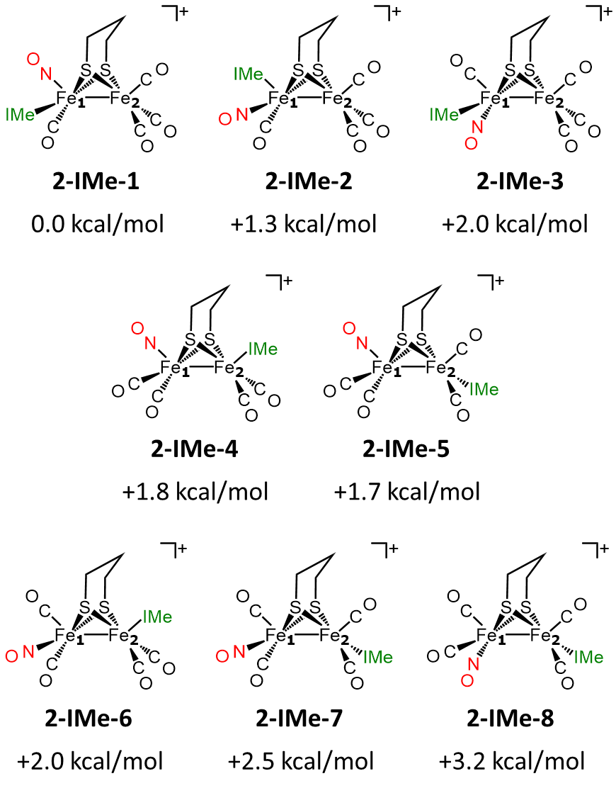
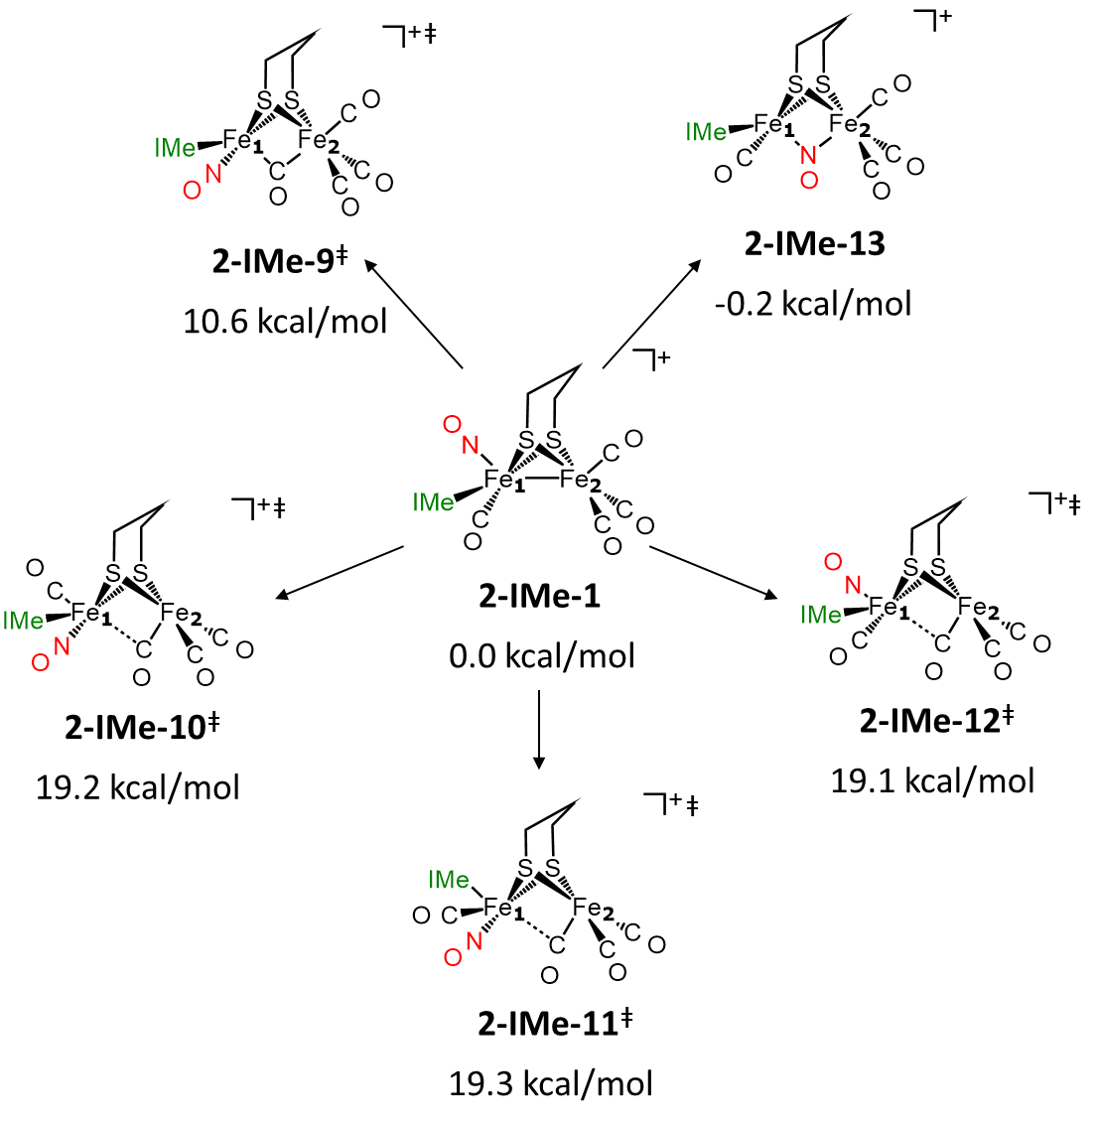
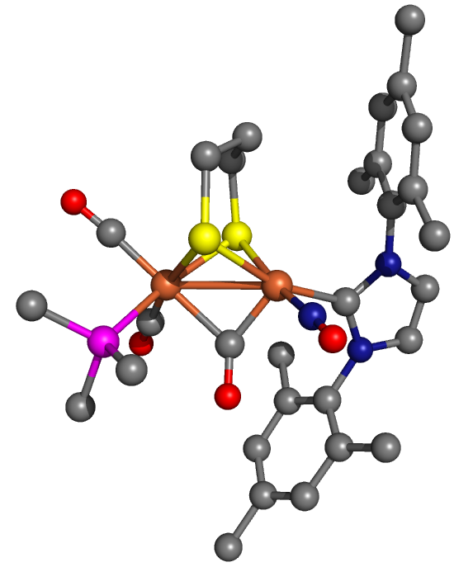
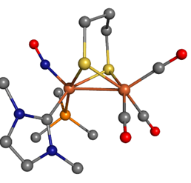
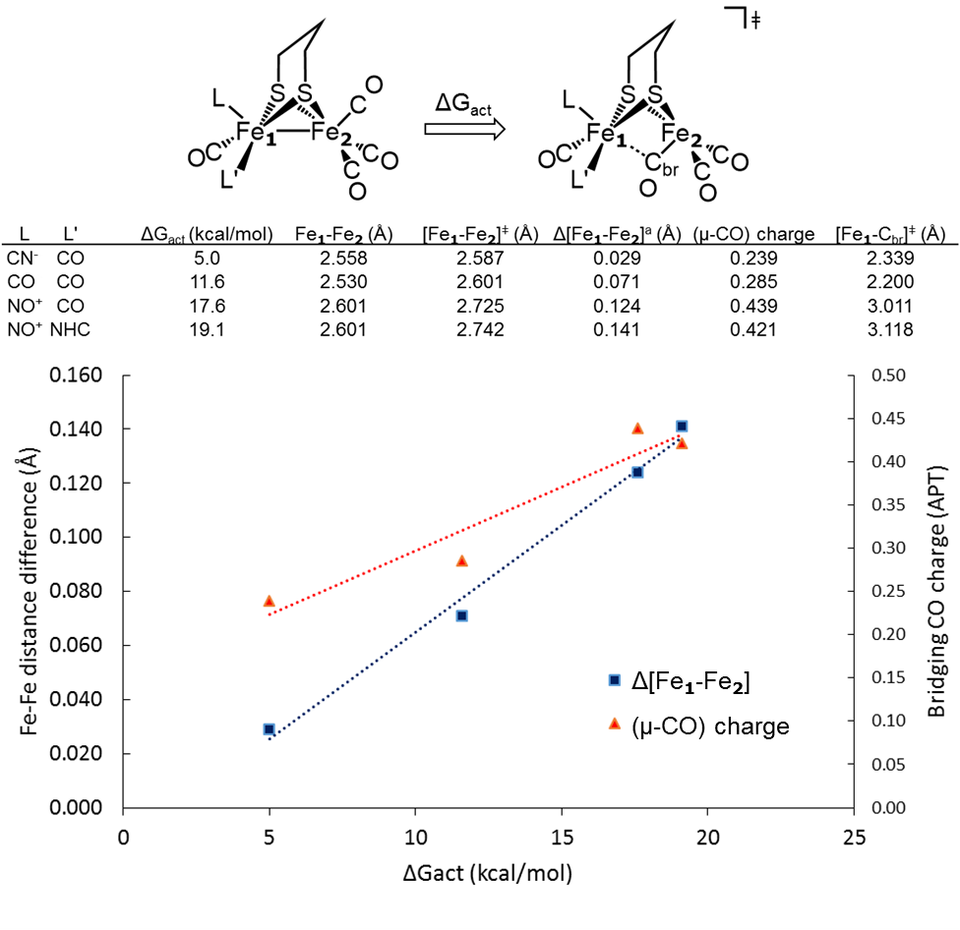
Detection of Charge Distribution in Diiron Hydrogenase Model Complexes by Regioselective Ligand Substitution Reactions
Ryan D. Bethel†, Danielle J. Crouthers†, Chung-Hung Hsieh§, Jason A. Denny†,
Michael B. Hall†* and Marcetta Y. Darensbourg†*
†Department of Chemistry, Texas A&M University, College Station, Texas 77843
§Department of Chemistry, Tamkang University, Taiwan 25157
Introduction
Regioselectivity in ¹³CO/¹²CO Ligand Exchange of 2-IMe
Left: three-dimensional stacked plot of the reaction of 2-IMe with ¹³CO(g) at 295 K in DCM showing the three CO bands of the all-¹²CO spectrum (red shapes) shifting to the two band pattern of the selectively substituted complex.
Right: low-field ¹³C NMR spectra in CD₂Cl₂ at 0 °C of (A) a sample of 2-IMe synthesized from ¹³CO enriched 1 and (B) a sample of 2-IMe synthesized from all ¹²CO 1, after 2h under 1 atm of ¹³CO. The peak at 207.1 ppm is ~15 times the intensity of the three peaks at 206.2, 204.0 and 202.9 ppm.
Inset: Reaction profile of IR bands corresponding to the ¹²CO at 2058 cm⁻¹ (blue), the ¹³CO at 2023 cm⁻¹ (green), and the NO at 1809 cm⁻¹ (red). The vertical lines show the times when ¹³CO, argon, and ¹²CO were flushed into the solution of 2-IMe.
The validity of µ-SRS[Fe(CO)₂L]₂ as models for the [FeFe] hydrogenase active site has been established by their incorporation into the apo-HydA protein.^{[1,2]} Ligand substitution reactions are keys to the preparation of analogues that inform on electron density distribution effects on structure and reactivity.
Mechanistic studies have established bimolecularity in the mechanisms of CO substitution (1 and 2), where Ea₁ > Ea₂ for CN⁻ and Ea₁ < Ea₂ for PMe₃, and oxidative addition of electrophilic ligands such as H⁺ and MeS⁺ .^{[3]}
The strongly electron withdrawing NO⁺ ligand is proceeds with isoelectronic CO exchange and significantly creates an electronic asymmetry of the FeFe complexes.^{[4,5]}
Computational Investigations of 2-IMe and 4-Ime
*Calculations performed using the Gaussian software package with B3LYP functional and 6-311+G(d,p) basis set.
Results
>> Question1: Is isomer observed in the solid state structure of 2-IMe is the thermodynamic product? Yes (Charts 1 & 2)!
Synthesis of pseudo-symmetric and asymmetric (µ-pdt)[FeFe] complexes depends on order of addition of nucleophilic vs electrophilic ligands:
Chart 1. The all-terminal isomers
Chart 2. The rotated structures
Nucleophile
then
Electrophile
Electrophile
then
Nucleophile
>> Question 2: Why is the fast exchange of Fe(CO)3 unit in 2-IMe not observed? Chart shows a very high barrier (>19 kcal/mol) to rotation.
>> Question 3: What is the origin of the regioselective ¹³CO/¹²CO exchange in 2-IMe?
When on the same Fe, the good donor properties of the NHC ligand are overwhelmed by the exceptional accepting ability of NO⁺. The latter creates a dearth of π-density available from the iron for backbonding to the CO of 2-NHC, resulting in a labile CO ligand on Fe₁.
Conclusions
We conclude that the observations of regioselectivity, CO lability, and rotational barriers, and stability in rotated structure all relate to the stabilization of µ-CO via FeCO (iron d-orbital to CO π*). This is supported by the calculated increase in Δ[Fe₁-Fe₂] (given as the difference of the Fe₁-Fe₂ distances of the calculated transition state and ground state structures) and decrease in the charge of the bridging carbonyl (calculated by APT) show a linear correlation (R² values of 0.99 and 0.92 respectively) with the rotation barrier of the Fe₂(CO)₃ in a series of complexes that vary in the CO substation of Fe₁: 1-CN⁻, 1, 1-NO⁺, and 2-IMe. These trends illustrate the effect of the π electron density of Fe₁, as modulated by CO/L substitution, on the rotation barrier of the Fe₂(CO)_{3.}
6-NHC
4-NHC
References
[1]Lubitz, W.; Ogata, H.; Ruediger, O.; Reijerse, E., Chem. Rev., 2014, 114, 4081-4148.
[2]Berggren, G.; Adamska, A.; Lambertz, C.; Simmons, T. R.; Esselborn, J.; Atta, M.; Gambarelli, S.; Mouesca, J. M.; Reijerse, E.; Lubitz, W.; Happe, T.; Artero, V.; Fontecave, M., Nature, 2013, 499, 66-69.
[3] Darensbourg, M. Y.; Lyon, E. J.; Zhao, X.; Georgakaki, I. P., Pro. Nat. Acad. Sci., 2003, 100, 3683-3688.
[4] Olsen, M. T.; Bruschi, M.; De Gioia, L; Rauchfuss, T. B.; Wilson, S. R., J. Am. Chem. Soc., 2008, 130, 12021–12030.
[5] Hsieh, C. H.; Erdem, O. F.; Harman, S. D.; Singleton, M. L.; Reijerse, E.; Lubitz, W.; Popescu, C. V.; Reibenspies, J. H.; Brothers, S. M.; Hall, M. B.; Darensbourg, M. Y., J. Am. Chem. Soc., 2012, 134, 13089-13102.

