Slide 1
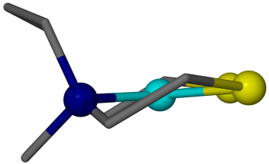
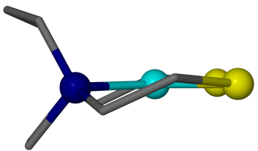
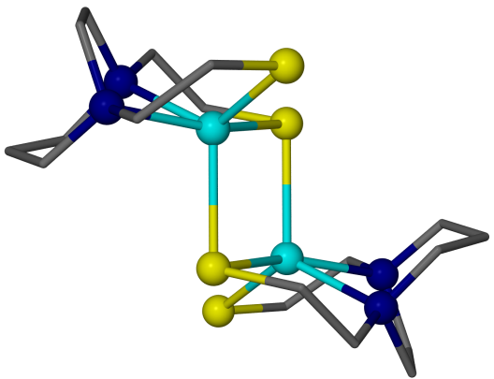
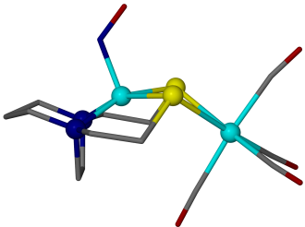
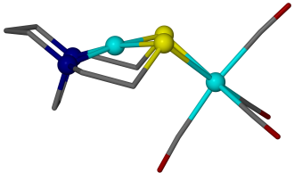
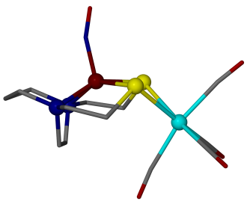
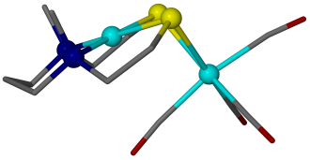
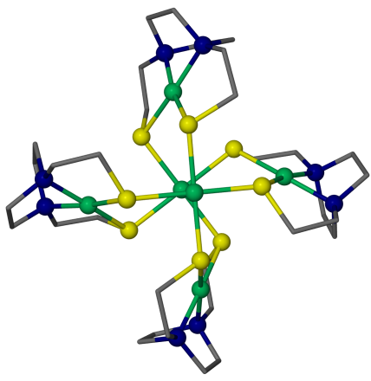
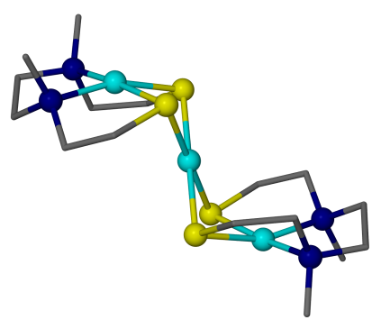
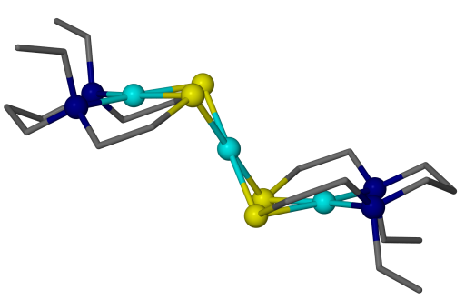
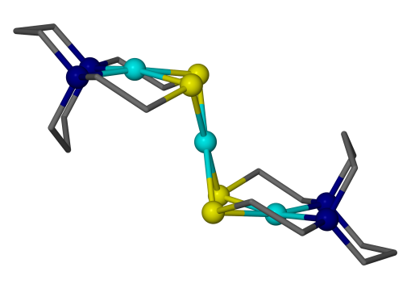
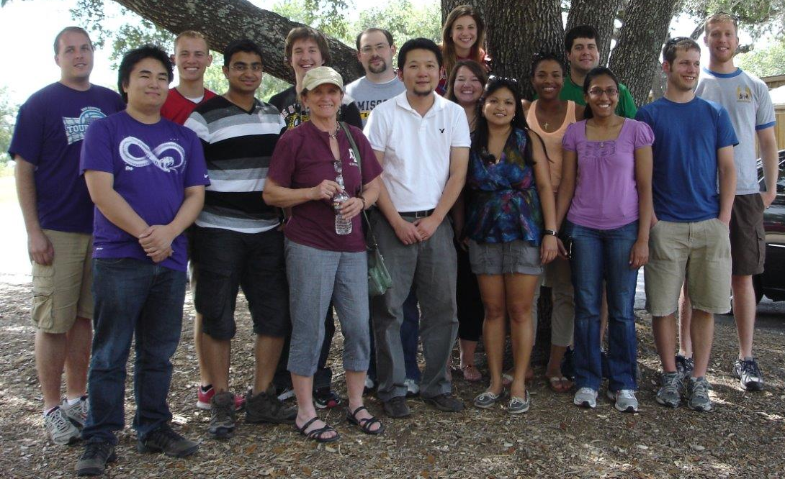
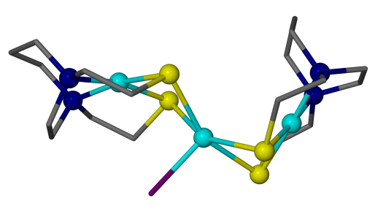
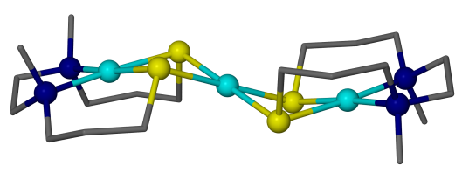
Metallodithiolates as Ligands in the Assembly of Poly-nuclear Complexes
A Bioinorganic Approach to Thiolate Reactivity and Coordination Chemistry
Jason A. Denny, Marcetta Y. Darensbourg
Texas A&M University, College Station, TX 77843
Overview: A comprehensive investigation has explored the ability of MN₂S₂ complexes to function as versatile ligands in the formation and selective synthesis of poly-nuclear clusters. Much of the inspriration and driving force
into the continued synthesis of MN₂S₂
complexes and their use as metalloligands
comes from the biological systems of
Acetyl-CoA Synthase (ACS) and [NiFe]-
hydrogenase, see inset. A structural
analysis of the basic MN₂S₂ complexes as
prospective ligands find 1) a large number
of cis-dithiolates in contiguous S-N-N-S square planar forms with potential as mono- or bidentate binding; and 2) a broad scope of modifications so as to tailor charge and S-donor ability of this new class of ligands. Examples are shown below.
As a bidentate ligand, the strained 4-membered M-(S)₂-M’ rings lead to ring opening in the presence of an external ligand such as added CO to the W(CO)₄ adducts. The subsequent stability of MN₂S₂•W(CO)₅ defines the MN₂S₂ as “hemi-labile ligands”. A functional example is a Ni(N₂S₂)Pd(CH₃)(Cl) complex which demonstrated faster CO binding and olefin insertion rates than traditional diphosphine and diimine Pd catalyst systems during polymerization reactions due to the increase electron donation from the thiolates to the Pd center.
The ∠S—M—S of 80º - 100º and S----S distance of ~3 Å of the MN₂S₂ complexes predispose them for bi-nucleation. The data-mining, structure search yielded three categories of the bridging bidentate ligand derivatives in the form of C₂ propellers, and C₃ or C₄ paddlewheels of formula [MN₂S₂]₂M’₂, [MN₂S₂]₃M’₂, and [MN₂S₂]₄M’₂, respectively. Overall the data search has yielded upwards of 300 structures whose metric parameters have been analyzed in total, permitting the first categorization of this unique class of ligands.
M(bis-mercaptoethyldiazacycloheptane) Complexes
[M(N₂S₂)]₃M’₂ C₃ Paddlewheel Complexes
This reaction wheel highlights the versatility of the N₂S₂ framework in binding different metal moities. In addition to changing the metal center many modifications have been made to the linker between donor atoms to change the sterics, electronics, solubility, and bio-recognition.
M = Cu
R = H
X = Cy
M = Ni
R = H; X = Cy
M = Ni
R = (CH₂)₃
X = 1
M = Ni
R = (CH₂)₃
X = 1
ACS [NiFe]-hydrogenase
M = Cu
R = H
X = 0
M = Ni
R = CH₂CH₃
X = 1
M = Ni
R = CH₂CH₂
X = 1
M(N₂S₂) Donor Properties as Bidentate Ligands Examined by Adducts with an IR Probe, W(CO)₄
M = Ni
R = CH₂CH₂
X = 1
M = Ni
R = CH₂CH₂
X = 1
M = Fe(NO)
R = CH₂CH₂; X = 1
As shown below the donor abilities of the MN₂S₂ complexes are greatest for the tetraanionic ligands followed by the dianionic ligands. The identity of the metal center also affects the donor ability as seen by V(O) as well as the M(NO) being lower their Ni counterparts.
[M(N₂S₂)]₄M’₂ C₄ Paddlewheel Complexes
Examples of NiN₂S₂ Complexes
The series below along with the C₃ and C₄ reaction wheels exemplify the diffuse nature of the lone pair orbitals on the sulfurs that are still reactive toward exogenous metal ions. Thus, the MN₂S₂ is capable of serving as a bidentate bridging ligand to a wide rage of transition metal systems with M---M distances ranging from 2.1 to 4.4 Å.
M = Ni
R = CH₂CH₂
X = 1
M = Ni
R = CH₂CH₂
X = 1
M = Ni
R = CH₂CH₂
X = 1
M = Ni
R = CH₂CH₂CH₂
X = 1
M = Pd
R = CH₃
X = 1
[M(N₂S₂)]₂Ni “Stair-step” Complexes
M = Ni
R = CH₂CH₂
X = 0
M = Ni
R = N/A
X = 0
R = N/A
X = 0
R = CH₃
X = 0
R = N/A
X = 0
R = CH₂CH₃
X = 1
The reaction wheel demonstrates the ability of two MN₂S₂ complexes to serve as bidentate ligands to a single square planar metal center.
R = (CH₂)₃
X = 1
R = N/A
X = 0
Acknowledgements
R = N/A
X = 0
R = CH₂CH₂
X = 1
MYD Research Group
National Science Foundation
Robert A. Welch Foundation
As illustrated in the graph above the N-to-N linker determines the steric constraints affecting the N---N distance which in turn controls the S---S distance. This is termed the “clothespin” effect and is one of the key feature in tuning the donor abilities of MN₂S₂ complexes when employed as a ligand.
R = CH₂CH₂
X = 1
M = Ni
R = N/A
X = 0
R = H
X = 0
R = CH₃
X = 0

